Slide 1
Bard (Demo)
Group 2 (undergrad)
Daniel Rodriguez, Kent Lizardo, Nick Rin-Laures, Victor Colome

Slide 2
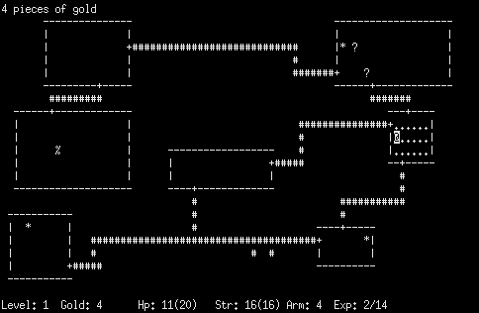
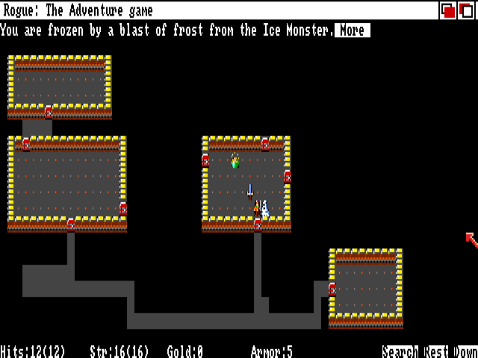
Project Recap
Our goal was to implement a classic 2D exploration game (Rogue) with controls using speech recognition.
Our development is currently focused on a feature-complete game, but the goal is to allow for natural user interaction by interpreting complex/nuanced voice commands.

Slide 3

Design Process
Interpreter design guided by formative user study.
Goal was to find out how users expected to use the interface: voice control activation, commands, etc.
Personas constructed from informal interviews.
Two design components: the game (to run) and the interpreter (for voice control).
Game design guided by the team’s previous game development experience:
Systems - screen layout with rooms, objects, and sprites
Core Loop - the user’s goals and how to accomplish them
Interactivity - what commands the user has to control the game
Steve
- unfamiliar with ‘retro’ style games
- used to voice control in devices like phones
John
- lots of game experience, knows Rogue
- new to NUI interactions, not used to devices

Slide 4
Design Features
Speech features supported (so far):
Movement commands (ex. “up”, “left”): For navigating the game’s level in the core loop.
Entity interaction (ex. “attack”): For interacting with game entities and making progress.
Item interaction (ex. “pick up”): For interacting with game items such as potions, keys, and inventory.
Other supported features:
Keyboard controls, for users who prefer traditional interaction (and for bug testing).
Voice-button activation, for use in scenarios with background noise (in development).

Slide 5
Development Process
Team has access to shared Github repository and Discord server.
Updates developed and tested on local PCs before being pushed with comments.
Feature ideation, implementation, and bug tracking discussed in Discord server.
Major development changes saved in branch and discussed before being committed.
Development Timeline
Voice recognizer and game engine implemented
Interviews designed, conducted, and reviewed
Character movement and voice interpreter implemented
Major bug squashed, allowing always-on voice recognition
Features added such as object interaction, enemy programming, and GUI

Slide 6
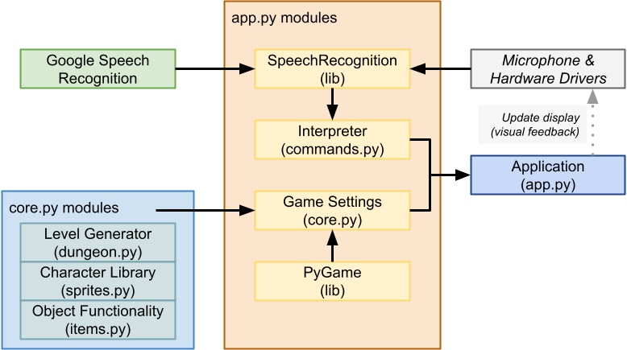
Development Framework
Third-Party materials:
PyGame-ce - Python-friendly game engine that displays level design and game objects [https://pyga.me/]
Google Voice Recognition - third-party API that takes speech input and returns text [https://cloud.google.com/speech-to-text]
SpeechRecognition - implements Google’s Voice Recognition API into Python [https://pypi.org/project/SpeechRecognition/]
System Diagram (with NUI loop)

